Slide 1
CLIENT VIEW

Slide 2
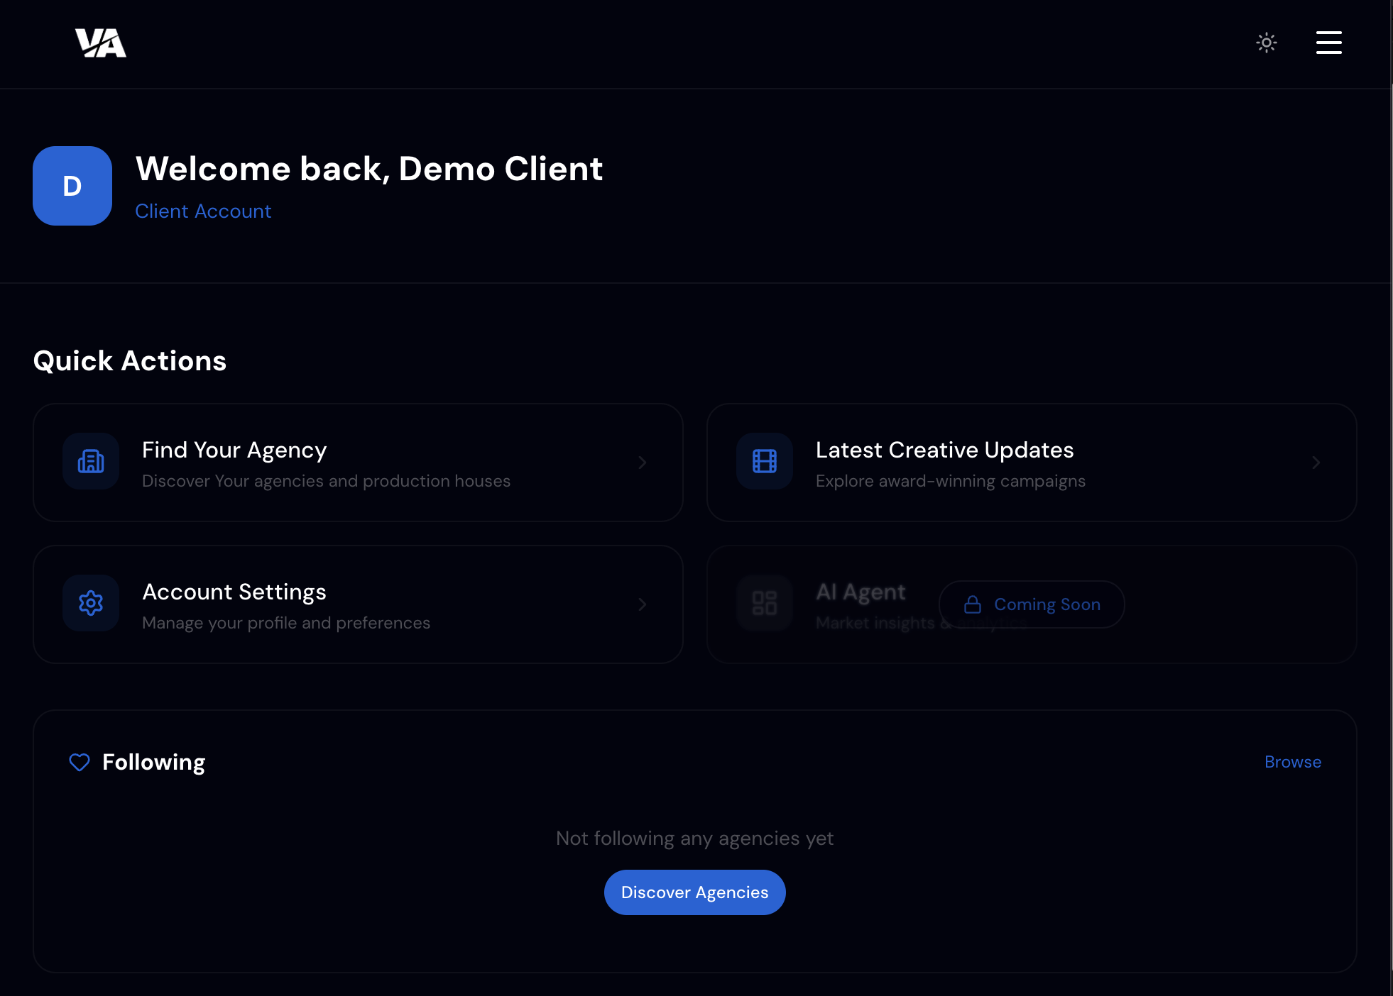
This page should have 5 CTA 1) find your agency -> ok
2) Find your production company -> missed 3) Latest creative updates 4) AI Agent
5) Account settings ok for the rest
1) Duplicate this CTA on the right “Find your Production Company

Slide 3
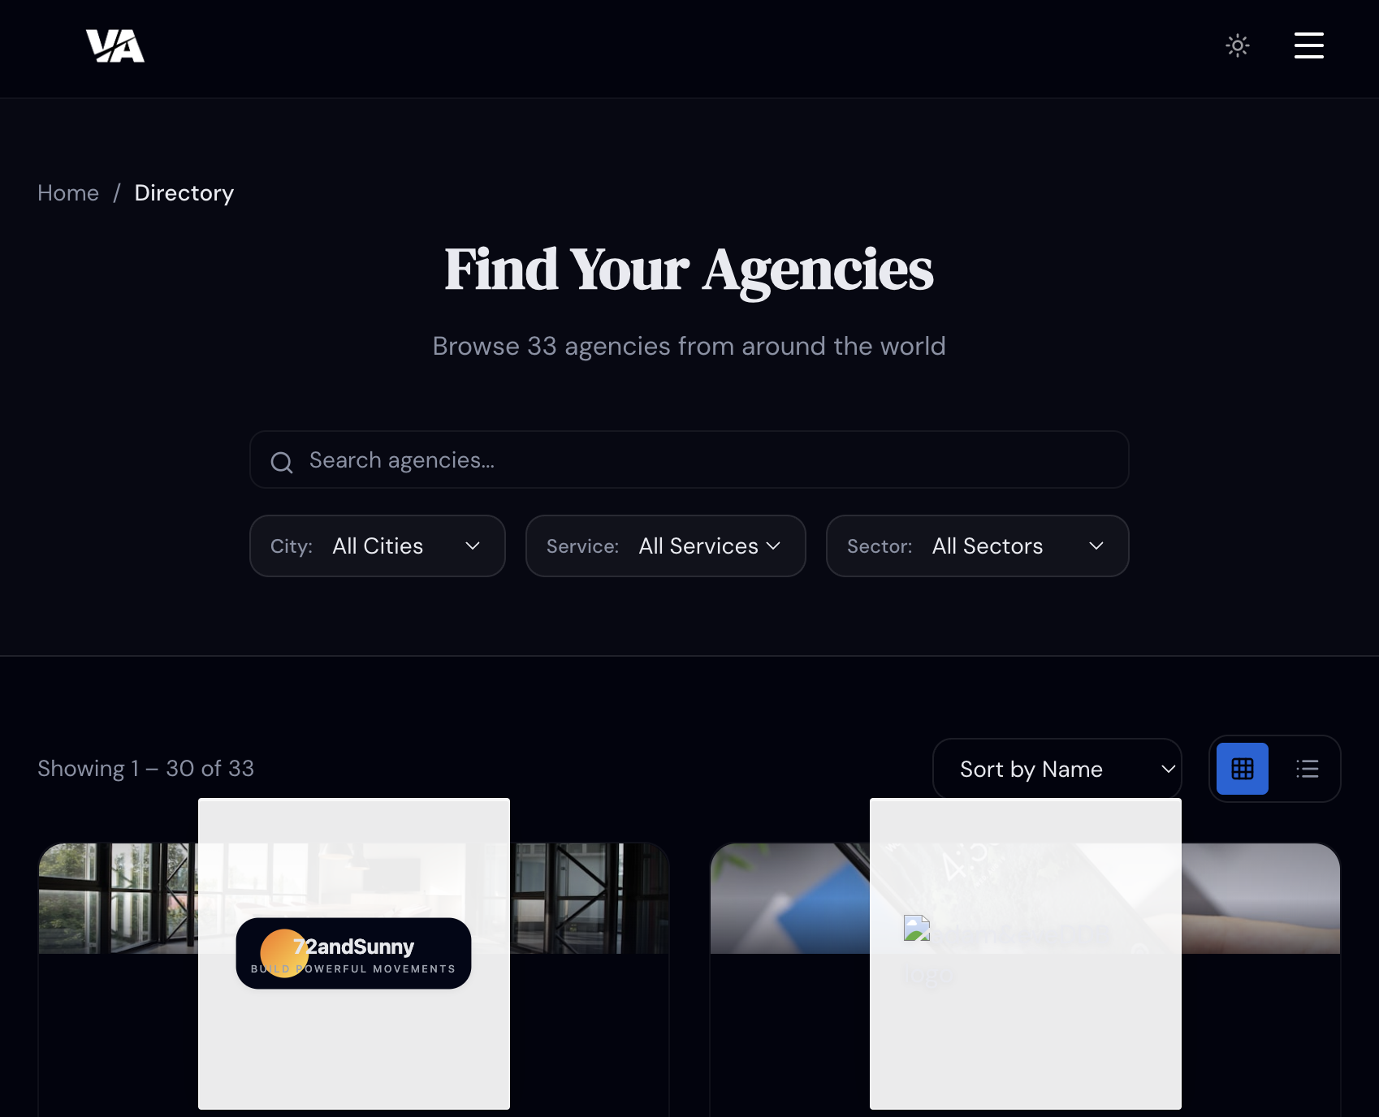
This filter should include sub-filters. The first one should be Region; once the Region is selected, the user can choose the Country; once the Country is selected, the user can choose the City.
If we provide the filter directly at City level, we would end up with an endless list of cities.
Industry and all Industries. non sector
Do not forget that you can select multiple industries, cities or services ☺

Slide 4
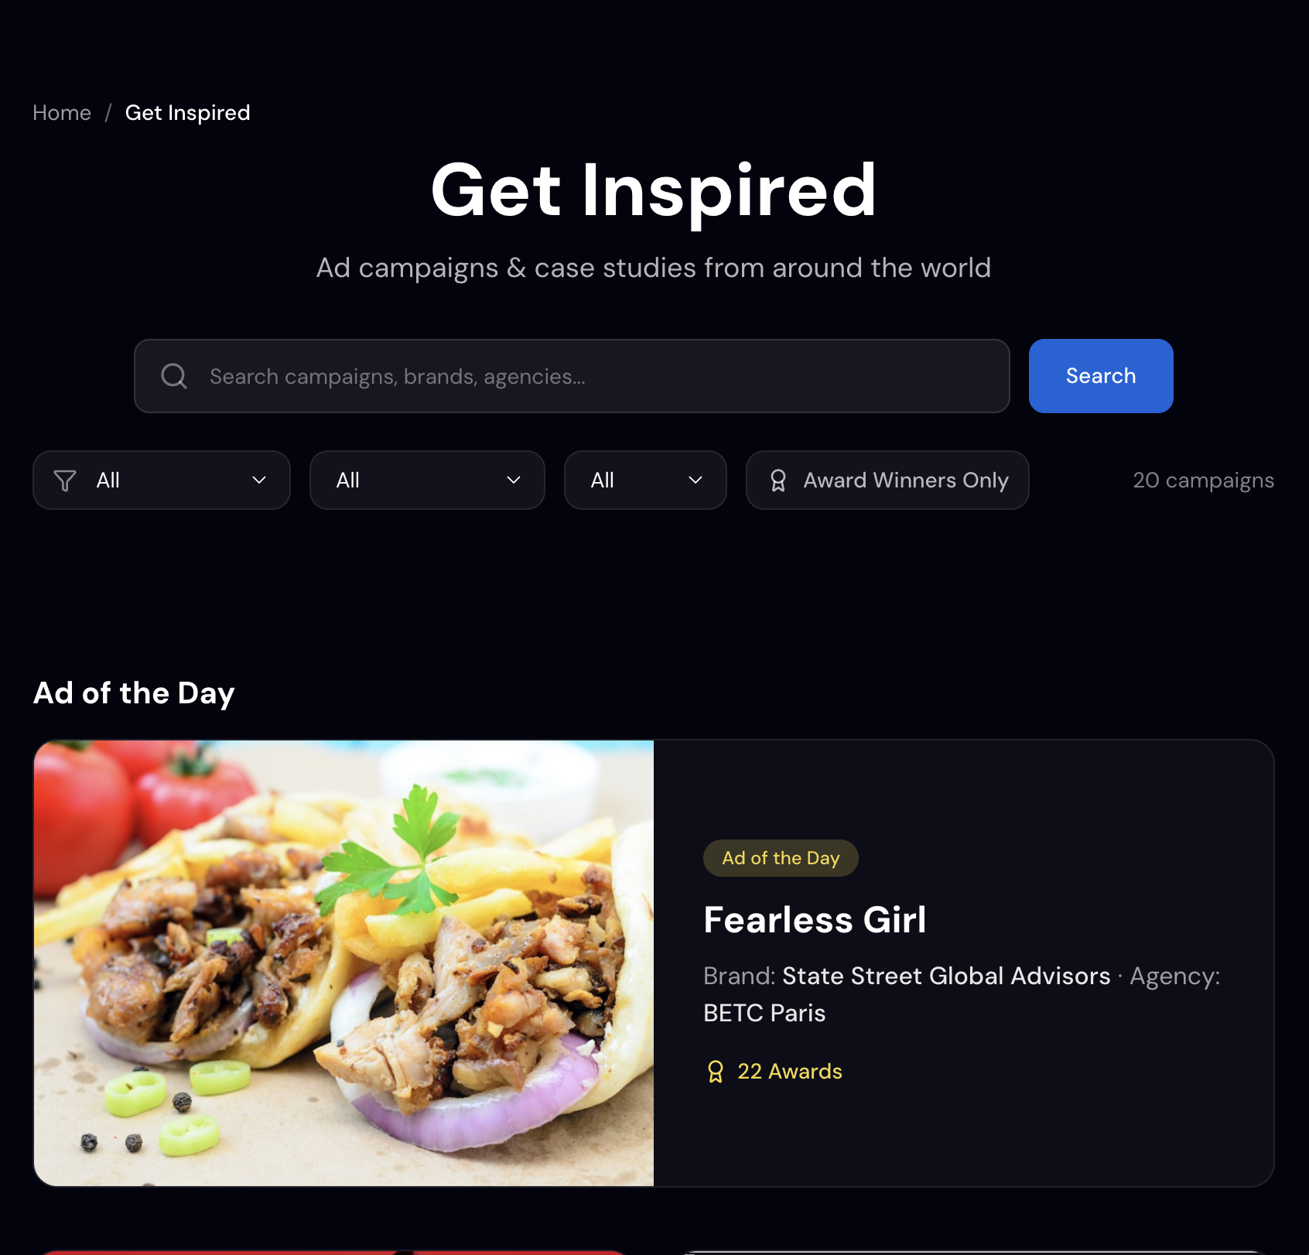
Ok for these filters, but please follow the same guidelines of the previous chart. In parallel we have never discussed about metadata related to articles or video. We should discuss a bit about this topic

Slide 5
Admin VIEW

Slide 6
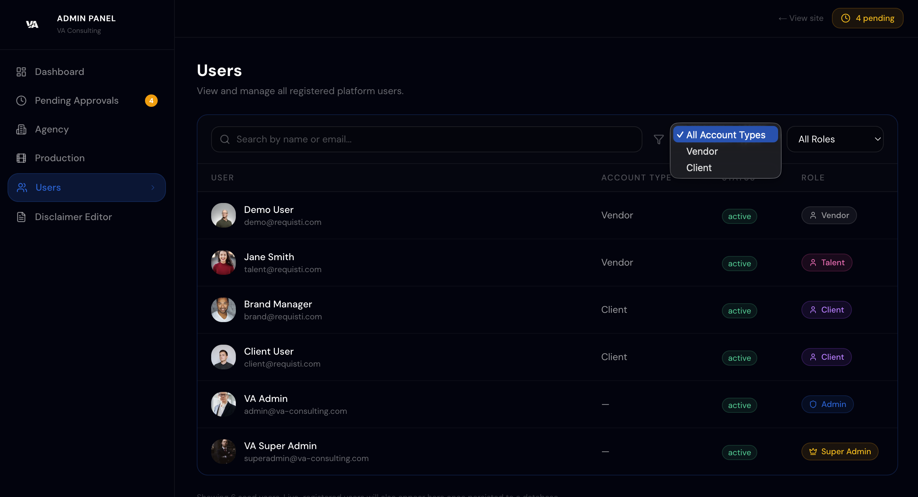
Ok your amend work but i can amend
Admin users to set up it as va consulting member
add

Slide 7
Super admin & Admin VIEW

Slide 8
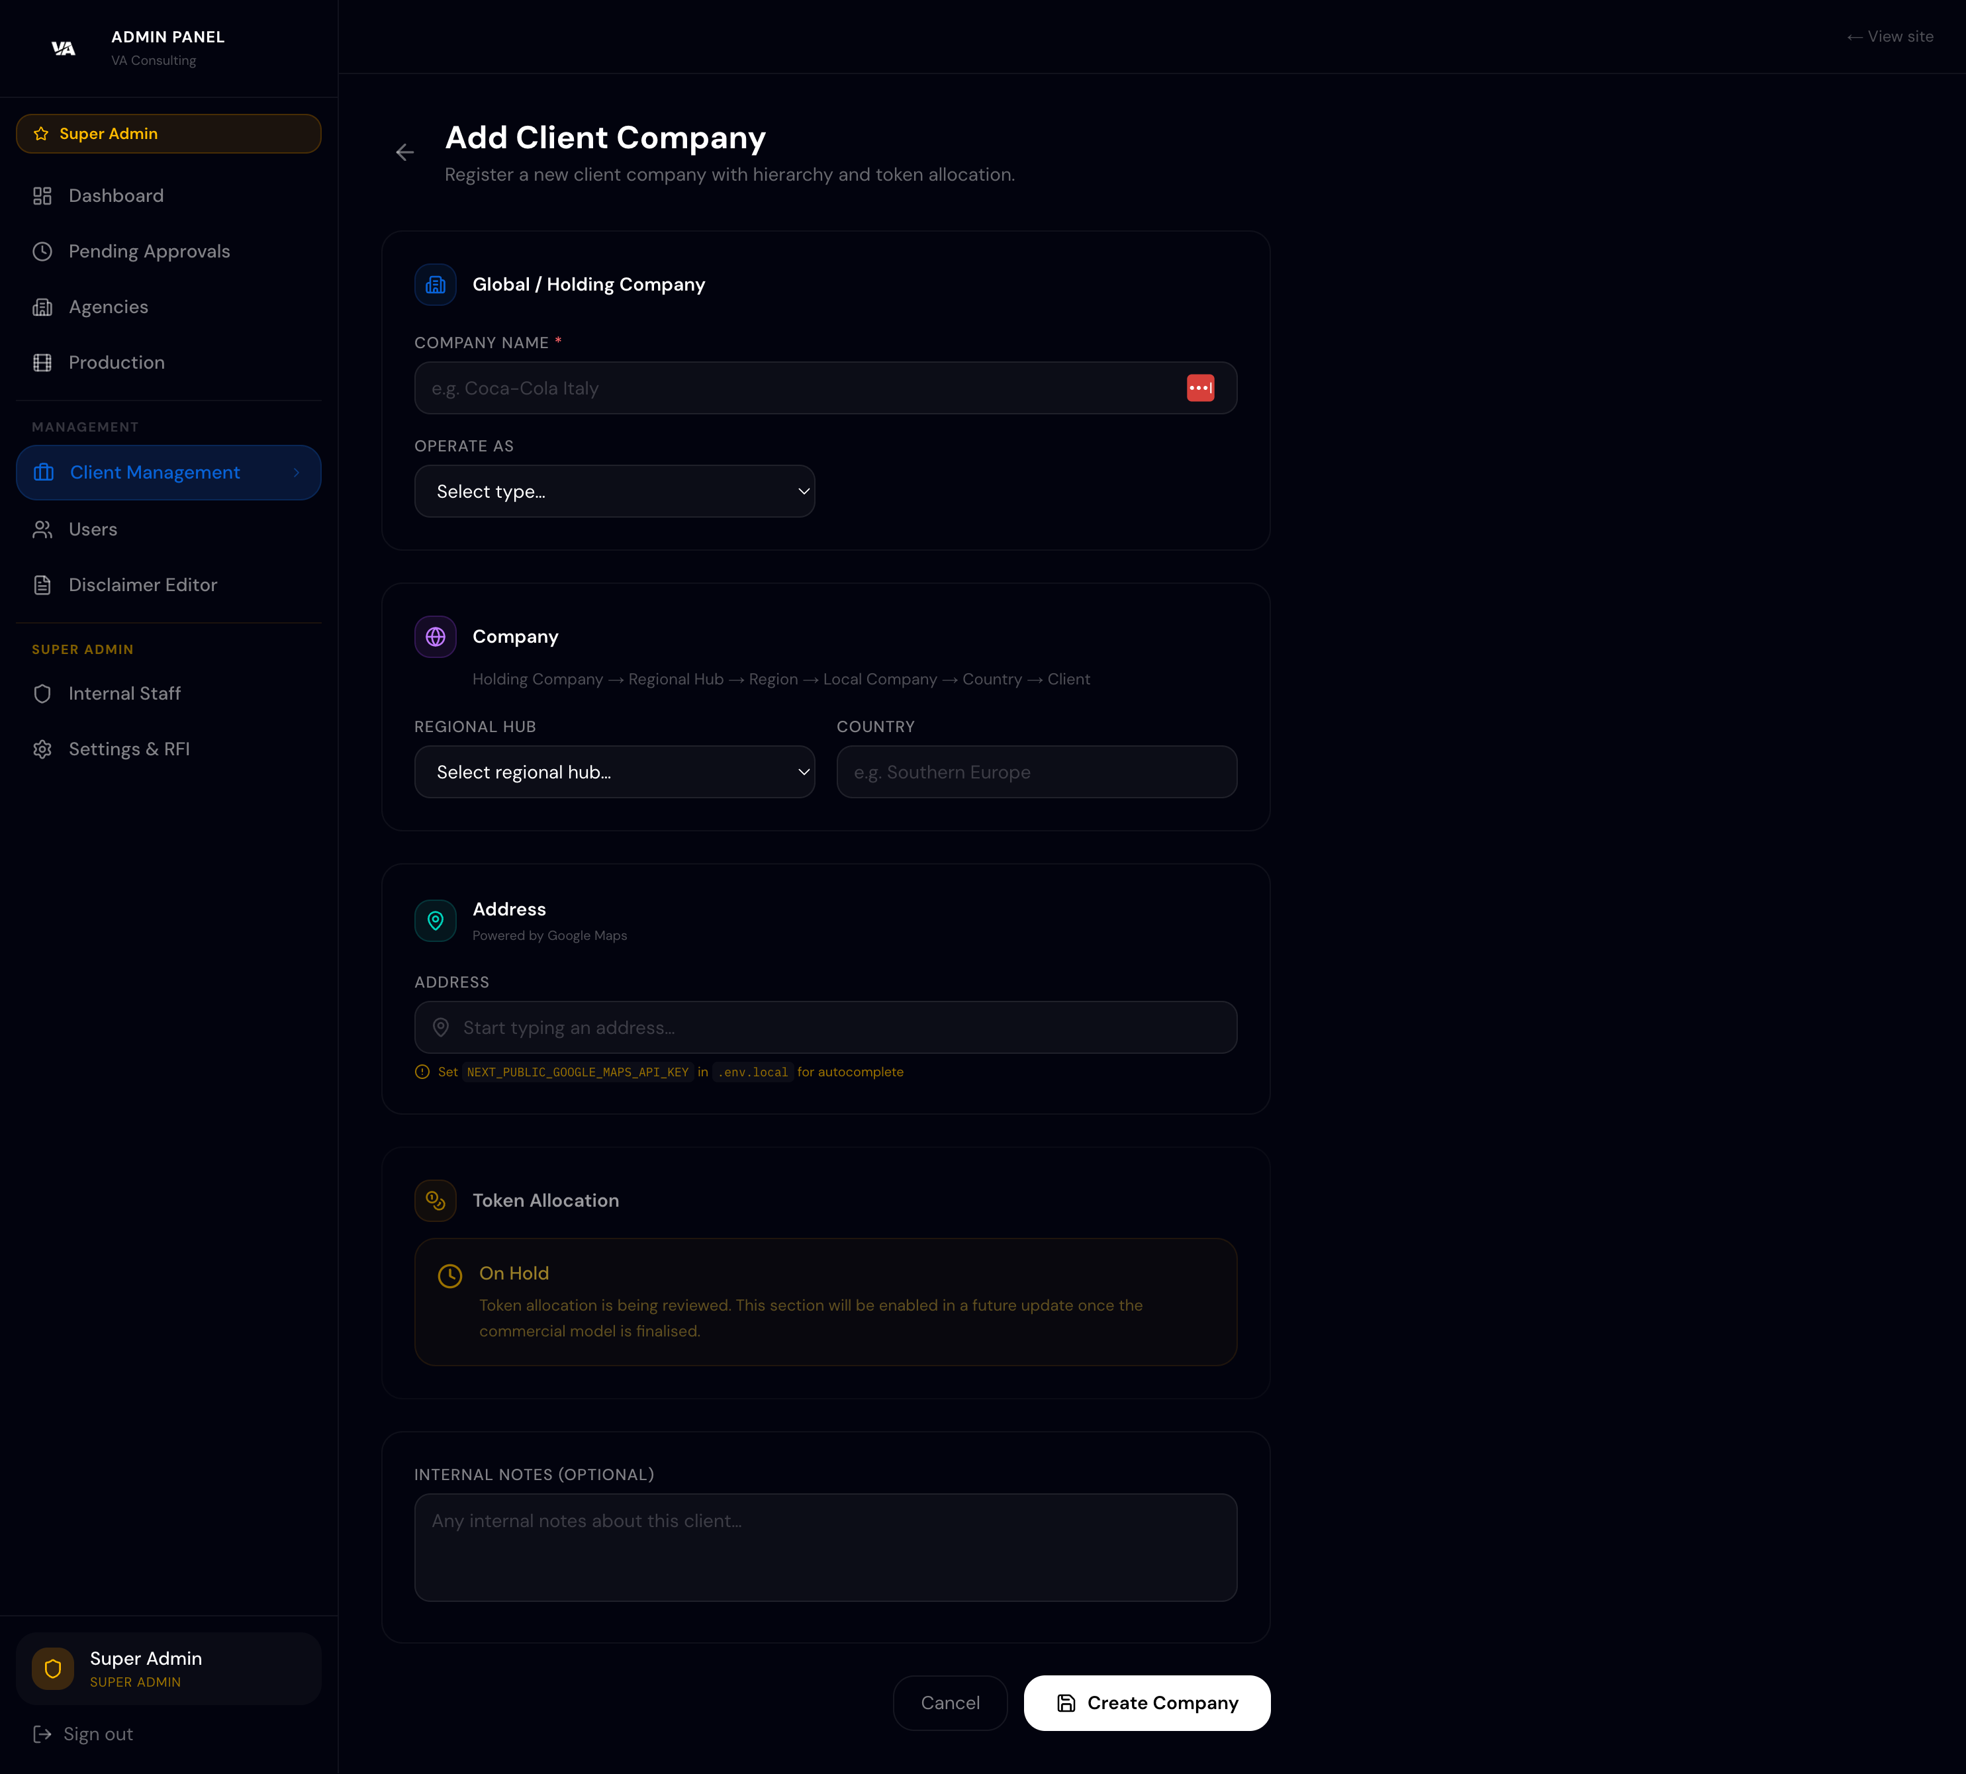
Please update the form as follows:
Rename the “Company” section to “Geographic & Operating Structure”.
Keep “Operate as” as the main driver of the form. Based on the selected value, the required fields should change dynamically:
Regional Hub: parent company + regional hub + covered regions/countries.
Multi Country: parent company + regional hub + region + covered countries.
Country Company: parent company + regional hub + region + country + local legal entity.
Add a separate “Region” field between Regional Hub and Country.
Fix the Country field: it should contain actual countries only. The current placeholder “Southern Europe” is a region, not a country.
Separate clearly:
Company Name
Legal Entity Name
Regional Hub
Region
Country
Address
For the address field, please add an Address Type selector: Headquarters / Legal Office / Local Office / Billing / Operational Office.
The key point is that Aura should not only have a cleaner UI, but a reliable structure to cluster clients by geography, operating model and legal entity.

